Slide 1

TEMPLATE CONTENT
Patient’s history and symptoms
Demonstration of the signs
Slide with additional investigations if required
Minimum 3 questions

Slide 2
Patients history and symptoms
(Example)
39 years old man
Pain in the right eye on waking up
Had several episodes in the past
Vision has “changed a bit” last 5 years
His mother has corneal transplantation

Slide 3
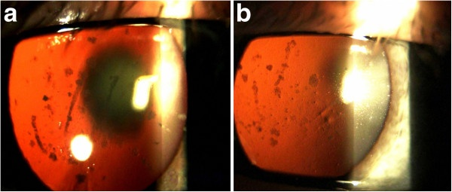
Demonstration of the signs

Slide 4
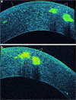
Аdditional investigations

Slide 5
Minimum 3 questions
What is most probable reason for patient’s symptoms?
What is the likely diagnosis?
What is prognosis and the risk for the children (one is 12 the other one is 5, both girls)?

